Slide 1
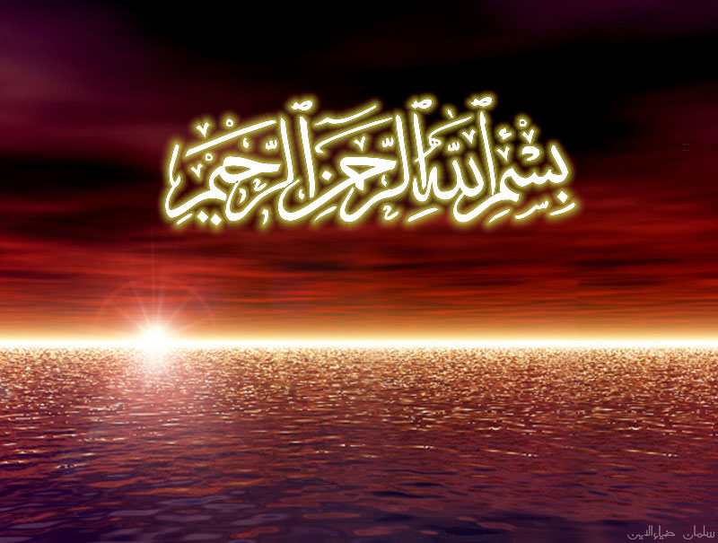

In the name of God,
the Merciful, the Compassionate

Slide 2
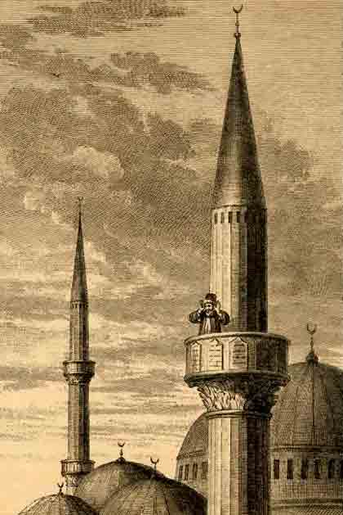
Adhan:
Call to Prayer

Slide 3
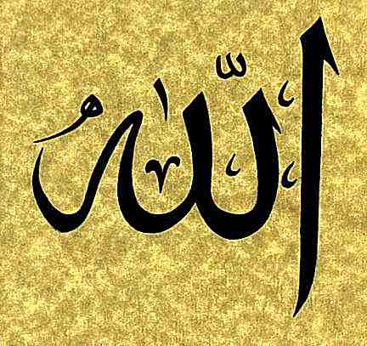
God is great!

Slide 4

I bear witness that
there is no deity but God

Slide 5

I bear witness that
Muhammad is
the Messenger of God

Slide 6
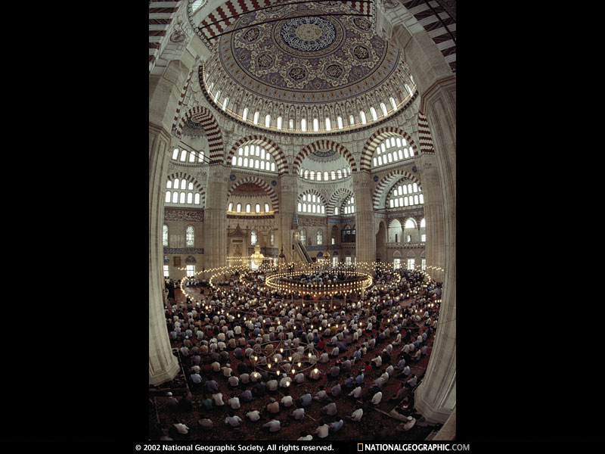
Hasten to prayer

Slide 7
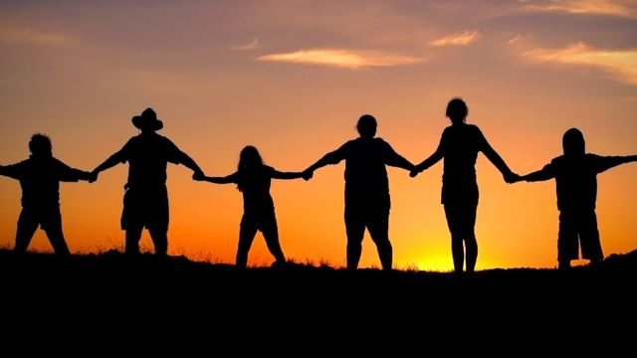
Hasten to success

Slide 8
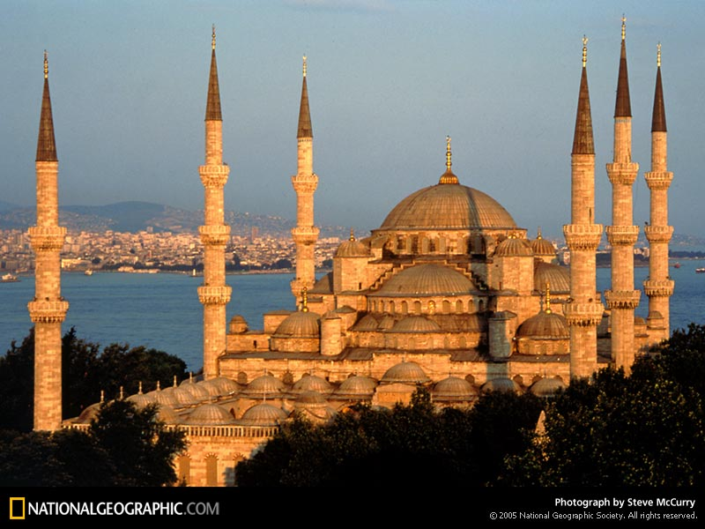
God is Great!

Slide 9
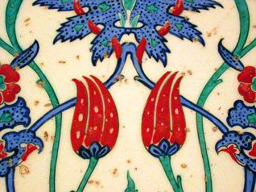
I bear witness that
there is no deity but God

